Slide 1
BURGER PARADISE
Shad Fernandez, Austin Frey, Alex Handzel, Bridget Houdyshel,

Slide 2
Domain
Interest in building an online ordering system for a burger restaurant
Website contains:
Home
Menu
Login
Registration
Order

Slide 3
Objectives
New customers will be prompted to create an account
Existing customers will be prompted to sign in
Upon Log In, Customers are sent to the Order page
Customers can update quantities of food they would like to order
Completion of order page, customers are directed to orders:
In-Progress Orders
Customers can Delete In-Progress orders
Completed Orders
Administrator account updates In-Progress Orders to Complete

Slide 4
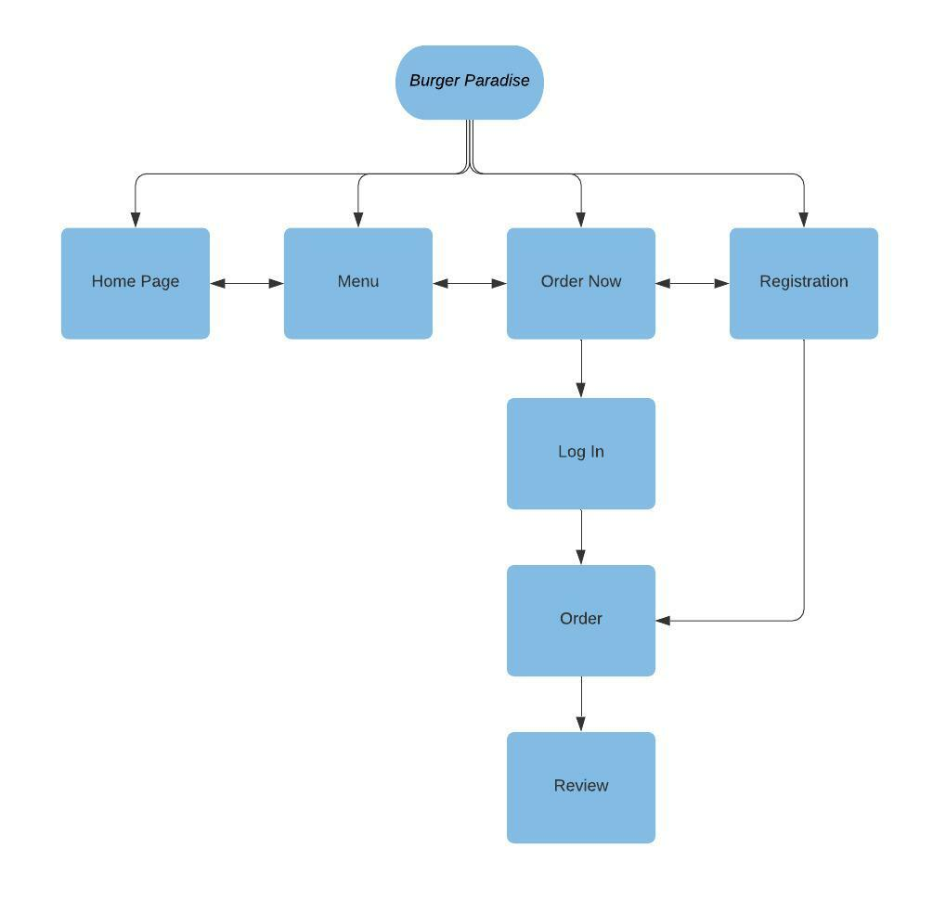
Workflow

Slide 5
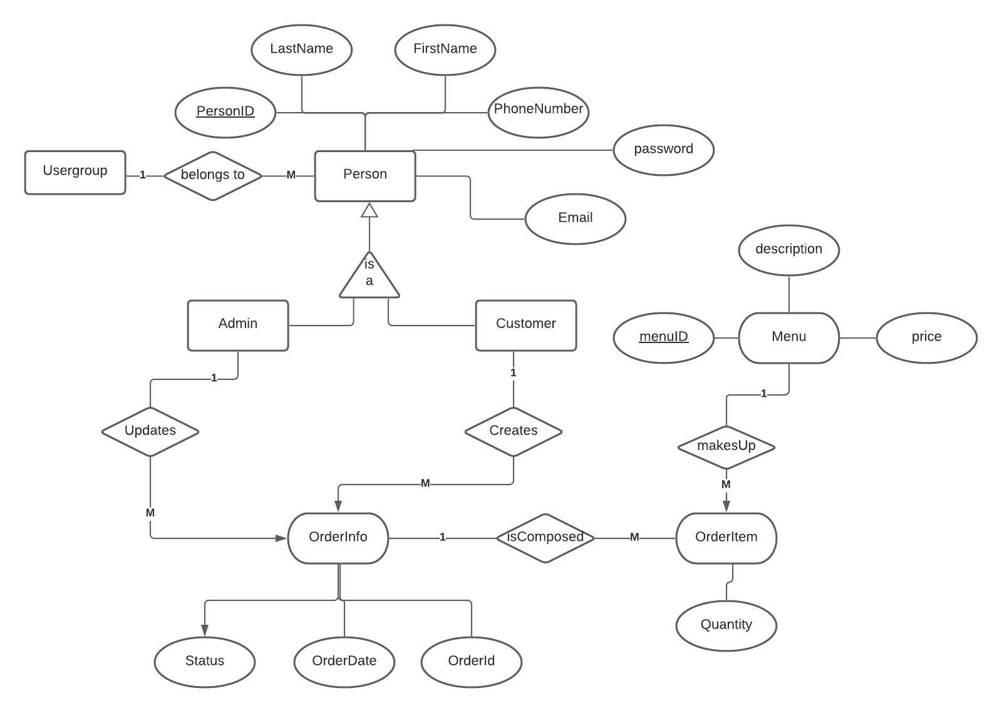
ER Model

Slide 6
Limitations
Menu/order cannot be easily updated
No guest account
Customers have to create/login to account
Cannot set date for Pick up

Slide 7
Questions?

